Slide 1

Pandit Deendayal Energy University
Summer Internship Evaluation
Prepared by :
Dev Jethva
(23MDS003)
Under the guidance of
Dr. Yogesh Kumar
Topic
White Blood Cell Image Classifier using Deep learning Techniques

Slide 2
Table of Contents
Introduction
Literature review
Problem Statement
Objective
Contribution
Proposed Model Architecture
Result
Conclusion & Future Direction
References

Slide 3
Introduction
Human blood is composed of blood cells and plasma. Blood cells make up 45% of the blood's volume and the liquid part, makes up the remaining of 55%. There are three types of blood cells: red blood cells, white blood cells, and platelets. White blood cells, which are crucial for fighting infections, are produced in the lymphoid tissue and bone marrow. These white blood cells are categorized into two main types: granulocytes and agranulocytes. Granulocytes include neutrophils, basophils, and eosinophils, while agranulocytes consist of monocytes and lymphocytes. Each type of white blood cell has a unique role in protecting the body against infections and diseases.

Slide 4
Literature Survey
References | Dataset | Method | Accuracy
Abdullah et al. [1] | 350 blood smear images | Classification with Proposed hybrid method | 99.5%
Bagido et al. [2] | CellaVision | MobileNetV2, VGG-16 | MobileNetV2: 79.79% VGG-16: 90.28%
Macawile et.al. [3] | ALL-IDB | Pre-trained model GoogleNet | 97.54%
Ma et al. [4] | DCGAN-generated with Matrix transformation | Pre-trained model ResNet + transfer learning | 91.68%
Almezhghwi et al. [5] | LISC | Pre-trained model VGG-16, VGG-19 | VGG-16: 90.6% VGG-19: 91.8%
Siddiques et al. [6] | BCCD | SqueezNet | 93.8%

Slide 5
Problem Statement
Current methods for identifying and classifying white blood cell subtypes are slow and error-prone, impacting medical diagnosis accuracy and efficiency. Recent deep learning advancements have improved classification of white blood cells in images. An improved deep learning approach is needed to accurately classify and localize the white blood cells, reducing errors and speeding up diagnostics.

Slide 6
Objective
The main goal of this project is to accurately identify different types of white blood cells in blood images. This can help with quicker and accurate diagnosis, reducing errors and saving time which can be done by comparing different methods.
By using deep learning techniques, our aim to not only classify white blood cells precisely but also find their exact positions in blood samples.
This will make the diagnosis process more consistent, allow for early disease detection, and provide reliable data for medical research.
Ultimately, we want to develop an easy-to-use and scalable tool that can be used in various healthcare settings, improving patient care and making diagnostic processes more efficient.

Slide 7
Contribution
Main focus on improving the classification of white blood cells in blood images using deep learning algorithms.
The contributions include preparing and enhancing image data, and optimizing various deep learning models, and conducting thorough training and testing to achieve high accuracy and speed in classification.

Slide 8
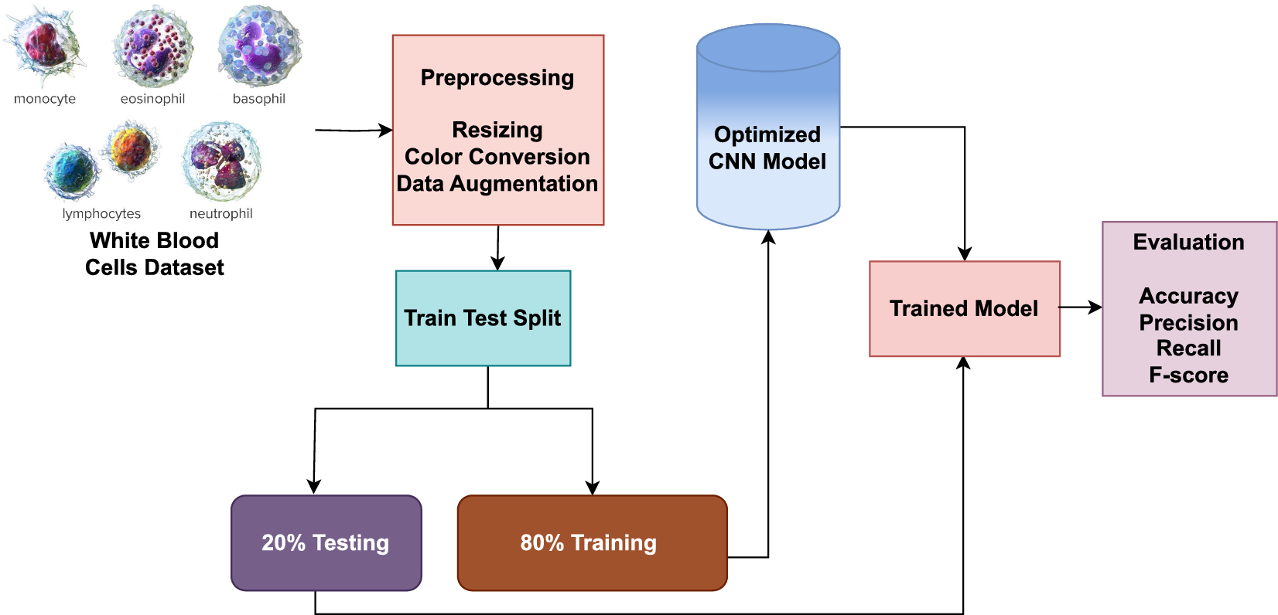
Proposed Model Architecture
Proposed Model Architecture:
credit: nature.com

Slide 9
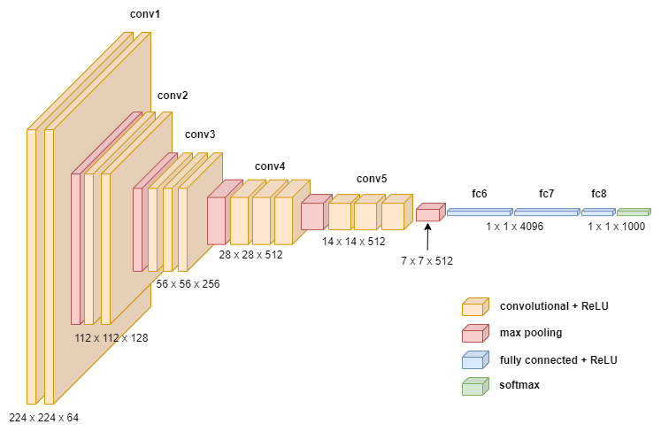
Model: Convolutional Neural Network Architecture:
credit: towardsdatascience

Slide 10
Results
Model Name | Train Accuracy | Training Loss | Validation Accuracy
DNN | 68.43% | 78.67% | 68.53%
CNN | 98.18% | 8.81% | 88.60%
VGG16 | 99.87% | 1.85% | 94.62%
VGG19 | 90.67% | 28.77% | 87.76%
ResNet50 | 37.77% | 188% | 39.37%

Slide 11
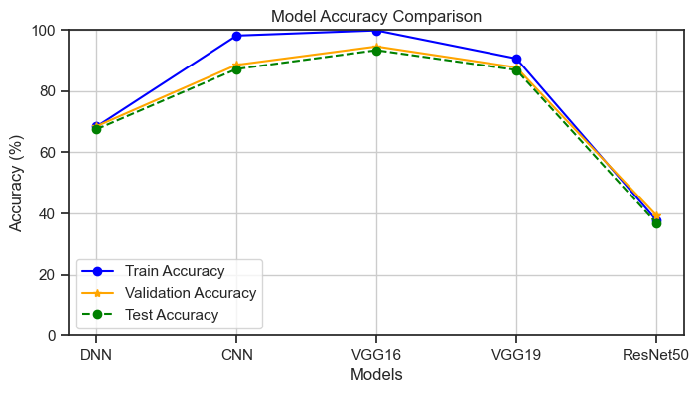
Result
Accuracy for different model generations on training, validation, and test data sets.

Slide 12
Results
Classification reports and the number of instances for each class of VGG16 model
Class Name | Precision | Recall | F1-Score | Support
Basophil | 0.91 | 0.95 | 0.93 | 237
Eosinophil | 0.95 | 0.98 | 0.97 | 596
Erythroblast | 0.91 | 0.96 | 0.94 | 294
Ig | 0.89 | 0.88 | 0.88 | 602
Lymphocyte | 0.96 | 0.88 | 0.92 | 241
Monocyte | 0.89 | 0.84 | 0.86 | 307
Neutrophil | 0.94 | 0.95 | 0.94 | 679
Platelet | 0.99 | 1.00 | 0.99 | 462
Accuracy |  |  | 0.93 | 3418
macro avg | 0.93 | 0.93 | 0.93 | 3418
weighted avg | 0.93 | 0.93 | 0.93 | 3418

Slide 13
Conclusion & Future Direction
This project showed that deep learning models, including deep neural networks (DNNs), convolutional neural networks (CNNs), and ResNet50, can accurately tell apart different types of white blood cells from images.
The high accuracy we achieved proves that using pre-trained models for medical image tasks works well and can help improve how we diagnose blood-related conditions.
This success sets the stage for future work, where we will compare other models to find the best ones for classifying white blood cells. The results from these comparisons will be put into a conference paper, adding useful knowledge to the field of medical image analysis and possibly helping future research and medical practices.

Slide 14
References
[1] Abdullah, E. & Turan, M. K. Classifying white blood cells using machine learning algorithms. Int. J. Eng. Res. Dev. 11, 141–152 (2019).
[2] Bagido RA, Alzahrani M, Arif M. White blood cell types classification using deep learning models. IJCSNS Int J Comp Sci Netw Secur. 2021;21:223 Available at: https://doi.org/10.22937/IJCSNS.2021. 21.9.30
[3] Macawile MJ, Quinones VV, Ballado A, Dela CJ, Caya MV. White blood cell classification and counting using convolutional neural network. 2018 3rd international conference on control and robotics engineering (ICCRE). IEEE; 2018. p. 259–263. Available at: https:// ieeexplore.ieee.org/document/8376476/
[4] Ma L, Shuai R, Ran X, Liu W, Ye C. Combining DC-GAN with ResNet for blood cell image classification. Med Biol Eng Comput. 2020;58: 1251–64. Available at: http://link.springer.com/10.1007/s11517- 020-02163-3
[5] Almezhghwi K, Serte S. Improved classification of white blood cells with the generative adversarial network and deep convolutional neural network. Comput Intell Neurosci. 2020;2020:1–12. Available at: https://www.hindawi.com/journals/cin/2020/6490479/

Slide 15
References
[6] Siddique MAI, Bin AAZ, Matin A. An improved deep learning based classification of human white blood cell images. 2020 11th international conference on electrical and computer engineering (ICECE). IEEE; 2020. p. 149–152. Available at: https://ieeexplore.ieee.org/ document/9393156/
[7] https://onlinelibrary.wiley.com/cms/asset/898be9f9-cc38-44ec-bd05-4131a252cef3/cytoa24839-fig-0002-m.jpg
[8] https://towardsdatascience.com/how-to-easily-draw-neural-network-architecture-diagrams-a6b6138ed875
[9] https://www.researchgate.net/figure/ResNet50-architecture-22_fig1_372274736

Slide 16
Thank you

